Slide 1
Kerberos
Kerberos is one of the authentication application.
It is implemented in client server architecture.
Before the communication starts, the client should be authenticated by the server and the server should be authenticated by the client.
After authentication on both sides, the client will send the request and the server will provide the service.

Slide 2
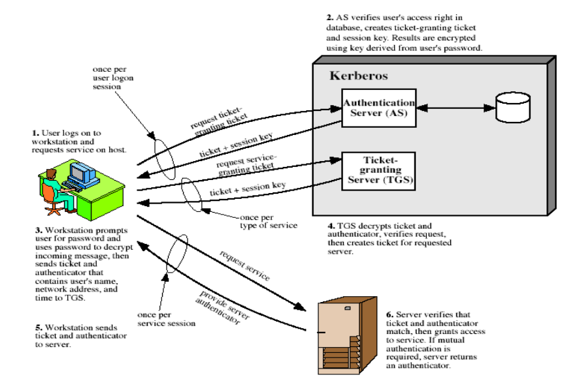

Slide 3
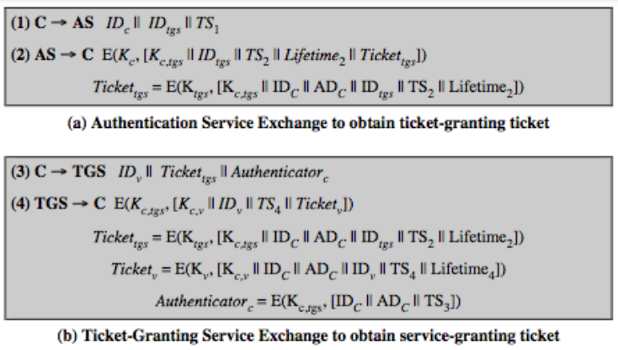


Slide 4

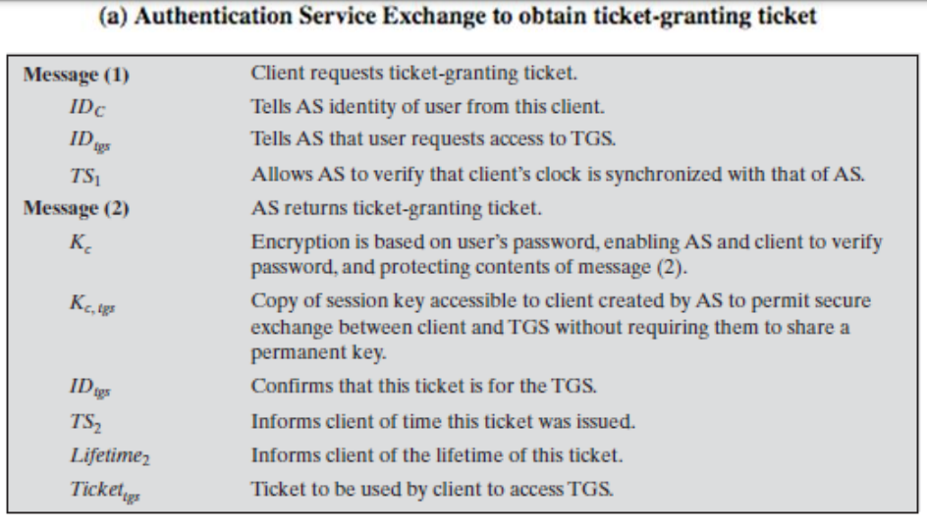

Slide 5
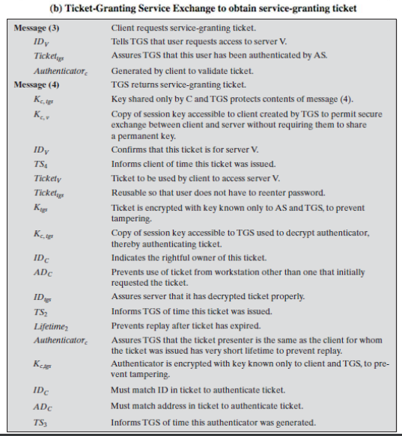


Slide 6
